Slide 1

Sales Data Analysis

Slide 2
Sales Data Analysis By- Satvik Sharma

Slide 3
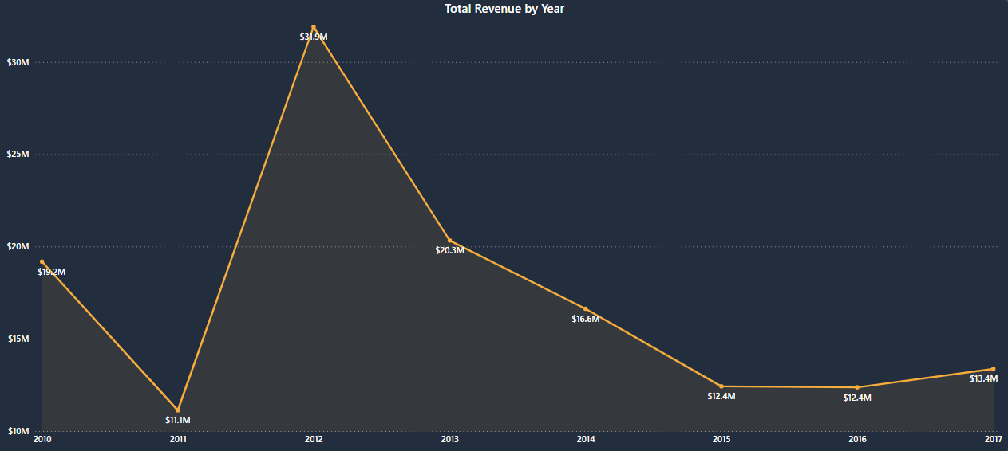
Problem Statement
Sales management has gained importance to meet increasing competition and the need for improved distribution methods to reduce costs and increase profits. Sales management today is the most important function in a commercial and business enterprise.

Slide 4
Revenue and Profit Analysis (2012 vs. 2016)
As observed from the graph, the revenue in the year 2012 was $31.90 million, and the profit was $9.21 million. By 2016, both metrics had significantly decreased. The revenue dropped to $12.37 million, and the profit decreased to $4.90 million. This represents a substantial decline of 62.5% in both revenue and profit over the four-year period.

Slide 5
Key Metrics
$137m+
$44m+
$440m+
Total Revenue
Total Profit
Average Profit/Order
Overall income generated from the sale of various products and services on the Amazon platform. This includes the sales of physical goods and digital products
Net earnings after all expenses have been deducted from the total revenue. This includes the costs associated with manufacturing, purchasing, etc.
represents the average amount of profit earned from each customer order after all costs and expenses have been accounted for.
510K+
10+
100
Units Sold
Products
Total Orders
Provides insight that indicates how many units of each product have been purchased by customers. It evaluates the popularity of products and sales trends.
Denotes the specific nature or genre of the product, such as Baby Food, Cereal, Office Supplies, Fruits, Vegetable, Household, or Clothes, etc.
Insight into sales activity helps assess customer engagement, track sales trends, and evaluate marketing and sales strategies.

Slide 6
Total Profit by Sales Channel
Total Profit by Region
Total Profit by Priority
Sub-Saharan Africa:
High Priority:
Offline Sales:
Total Profit: $12.2 million.
Highest contributing region to total profit.
Total Profit: $16.9 million.
Highest contributing priority level.
Contribute 56.42% of total profit.
Total Profit: $24.92 million.
Europe:
Low Priority:
Online Sales:
Total Profit: $11.1 million.
Second highest contributing region to total profit.
Total Profit: $10.9 million.
Second highest contributing priority level.
Contribute 43.58% of total profit.
Total Profit: $19.25 million.
North America:
Critical Priority:
Total Profit: $1.5 million.
Lowest contributing region to total profit.
Total Profit: $6.7 million.
Lowest contributing priority level.

Slide 7
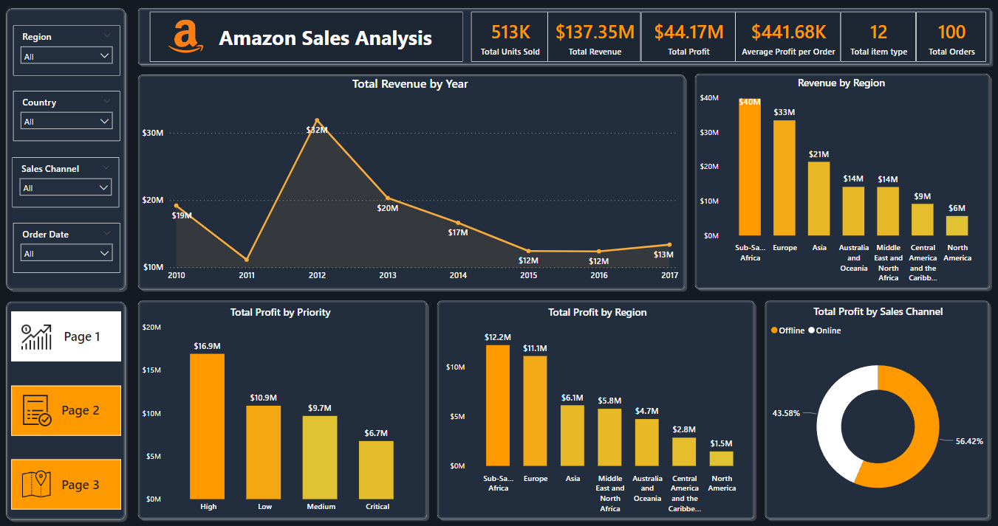

Slide 8
Profit by Item Types
Revenue by Country
Profit by Country
Honduras:
Djibouti:
Cosmetics:
Revenue: $6.3 million
Highest revenue - generating country
Total Profit: $2.4 million
Highest profit - generating country
Total Profit: $15 million
Highest profit-generating item type
Myanmar:
Myanmar:
Household:
Revenue: $6.1 million
Second highest revenue -generating country
Total Profit: $1.8 million
Second highest profit-generating country
Total Profit: $7 million
Second highest profit-generating item type
Iran:
Norway:
Fruits:
Revenue: $2.8 million
Lowest revenue - generating country
Total Profit: $0.79 million
Lowest profit - generating country
Total Profit: $0.12 million
Lowest profit-generating item type

Slide 9
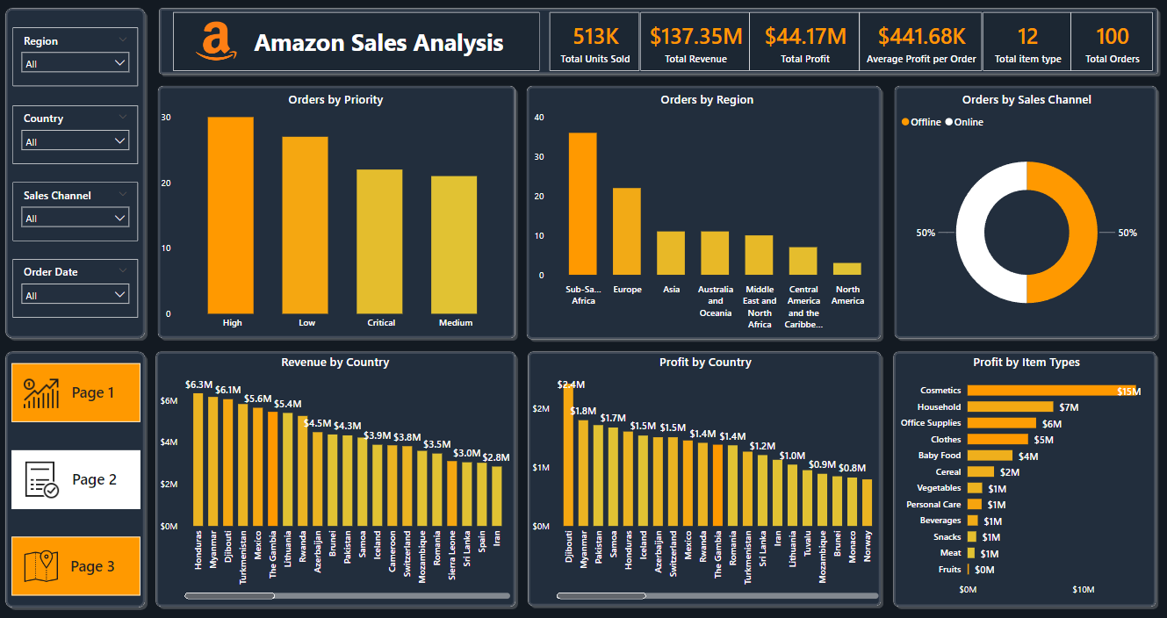

Slide 10
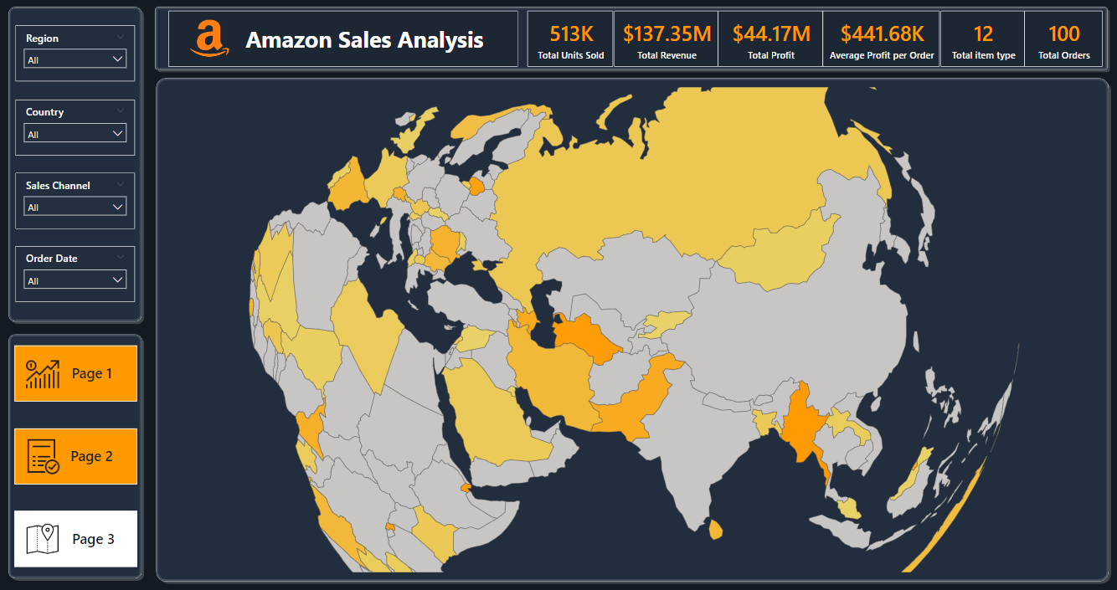

Slide 11
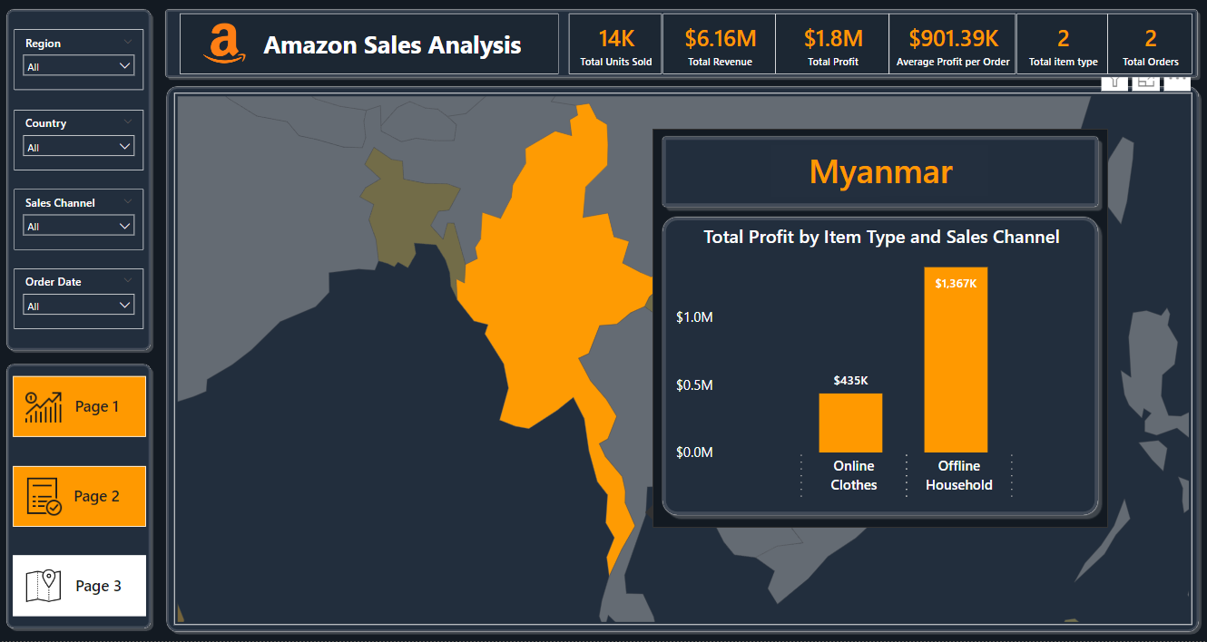

Slide 12
Conclusion
Optimize Online Operations: Enhance website performance, user interface, and personalized recommendations to boost online sales.
Leverage Offline Strategies: Strengthen in-store promotions and customer service to maintain and increase offline profit margins.
Reassess North America Strategies: Adjust strategies to identify growth opportunities and increase profitability in North America.
Enhance Market Presence: Implement targeted marketing campaigns and localized strategies in Honduras, Myanmar, and Iran to sustain and boost revenue.
Boost Sales in Key Categories: Increase profitability in household items, fruits, and cosmetics through promotions, product enhancements, and innovation.
Optimize Item Prioritization: Allocate resources and marketing to high-priority items, reduce costs, and enhance appeal for critical priority items.
Expand in High-Profit Regions: Focus on product offerings and marketing in Sub-Saharan Africa and Europe for higher profitability.

